Slide 1
Deciphering and Reconstructing Interrelations Among Dry Eye, Depression, and Irritable Bowel Syndrome: A Mendelian Randomization Study
盧佳欣

Slide 2
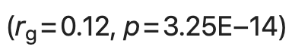
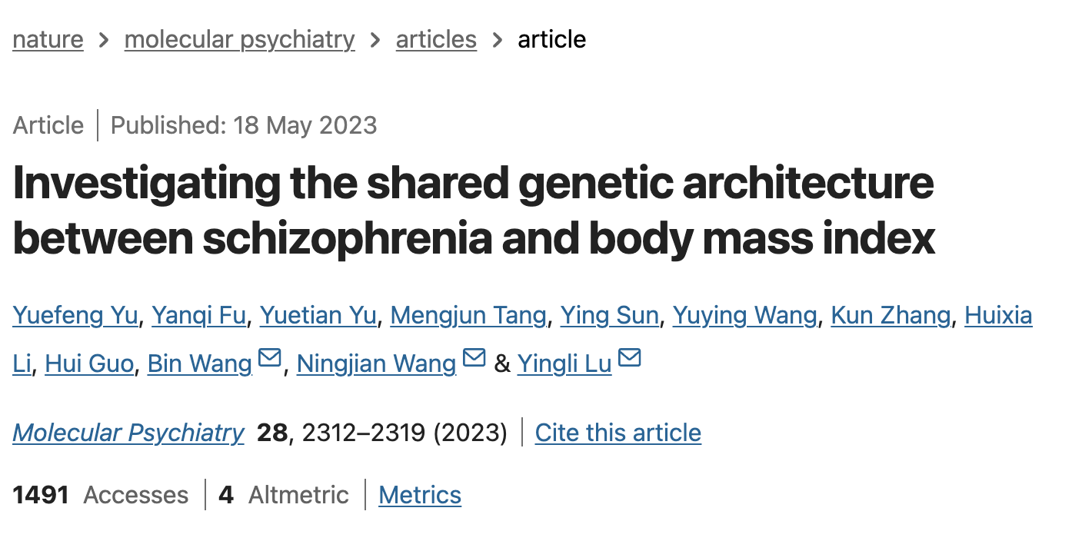
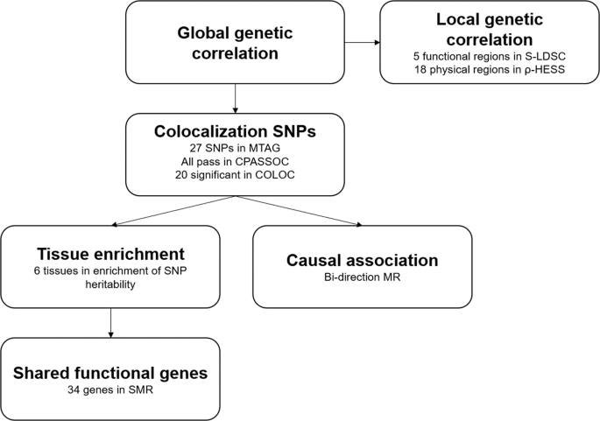
Data source: BMI from UKB, schizophrenia from a previous meta-GWAS

Slide 3
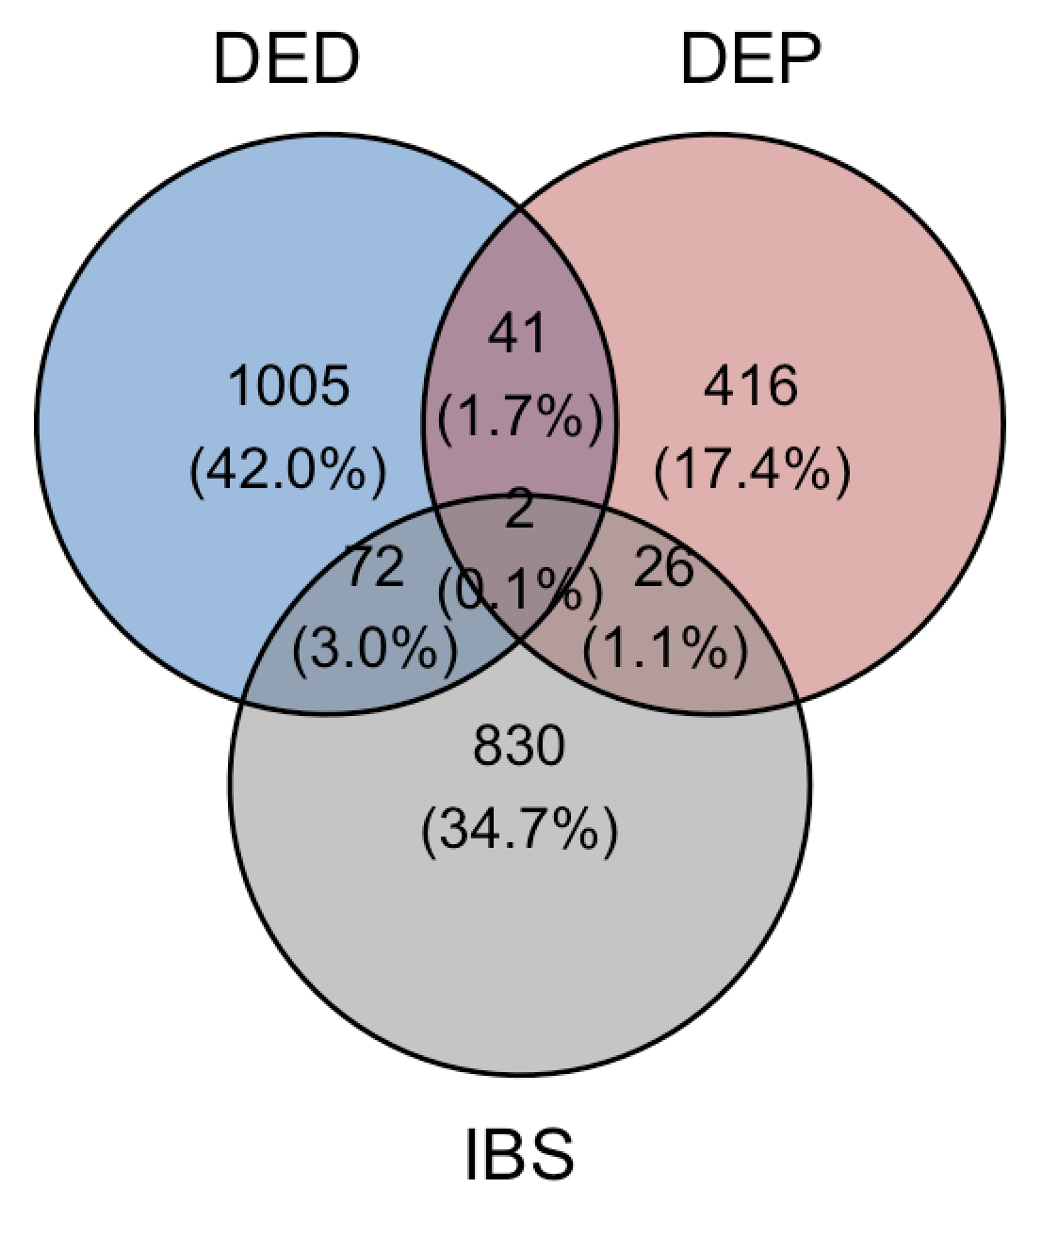
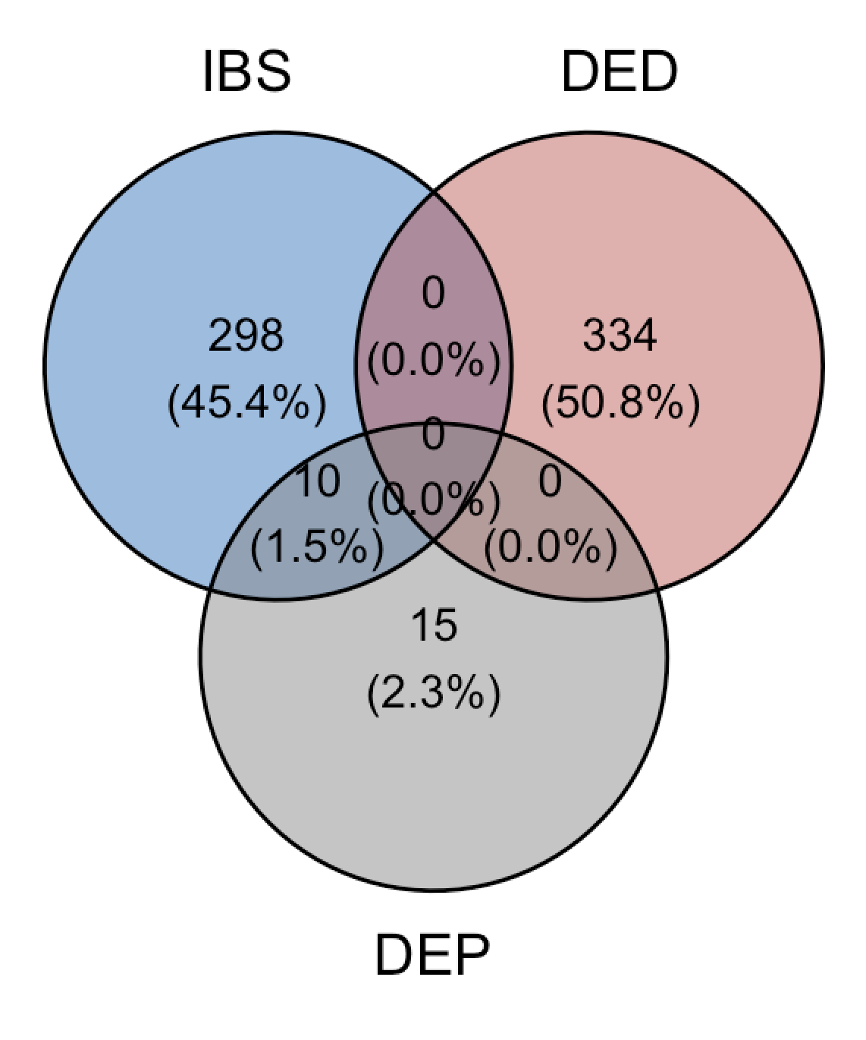
Genetics
FUMA
positional (maximum dist < 10 kb)
eQTL (FDR < 0.05)
chromatin interaction (FDR < 1e-6)
–
MAGMA
positional (window size = 0 kb)
GPER1 (p_{IBS} = 0.049, p_{DED} = 0.048, p_{DEP} = 0.041)
PAPL2 (p_{IBS} = 0.045, p_{DED} = 0.022, p_{DEP} = 0.019)
MAGMA p < 0.05
Table 2. (part)
FUMA
Notes:
retinitis pigmentosa 視網膜色素變性

Slide 4
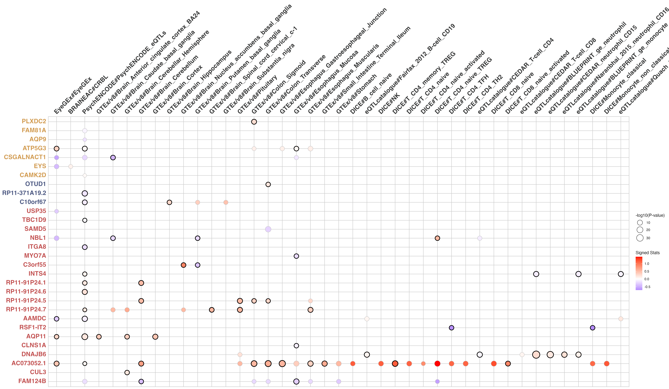
Eye
Brain
Gut
Immune

Slide 5
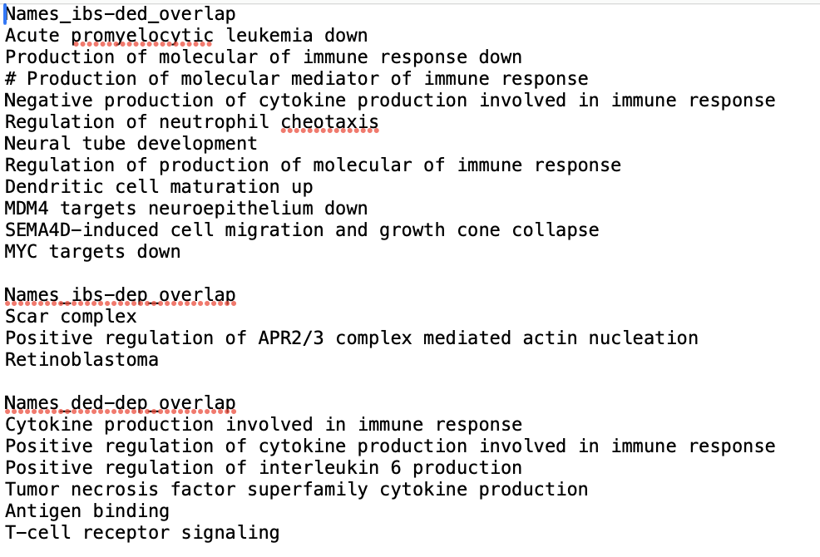
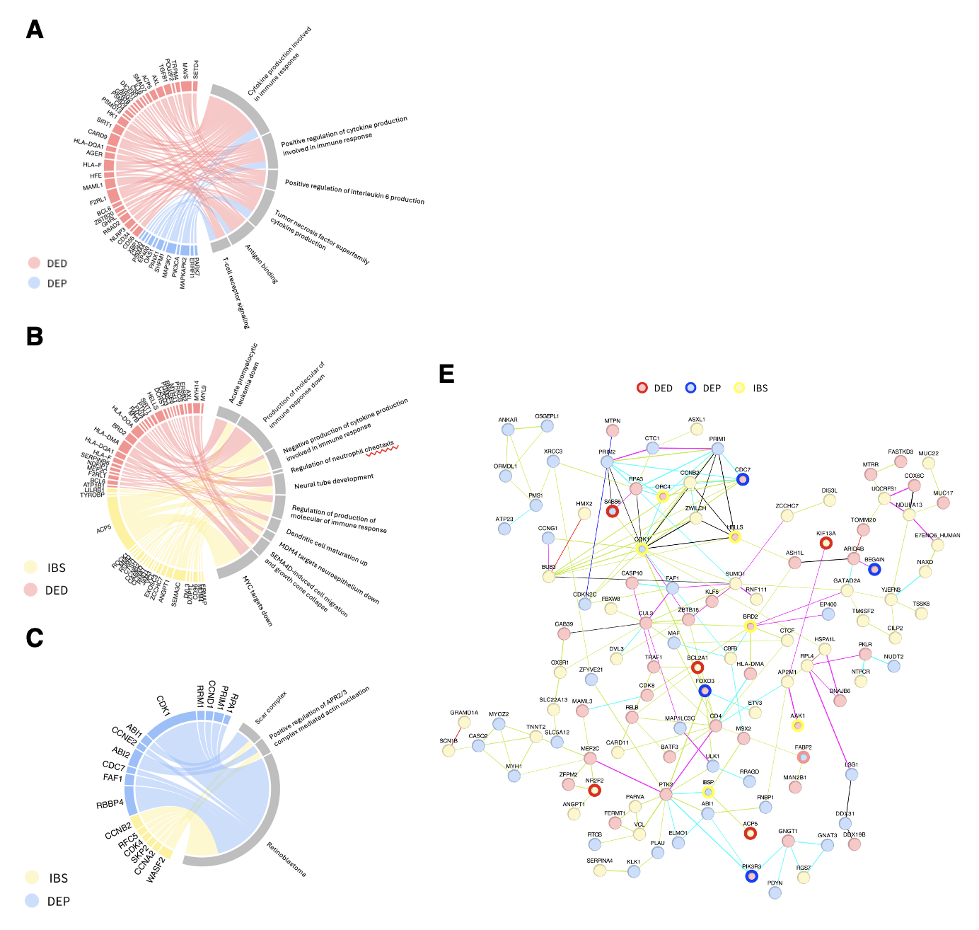
Functional Enrichment
A–C Gene Ontology / MAGMA
E Protein-protein interaction / STRING
–
LAVA – local h² & r_{g}
r^2 < 0.6 defined as a LD block
IndSigSNP = p<1e-5 within each LD block
candidate SNPs = in LD with IndSigSNP
genomic risk loci marked by IndSigSNP
liftover hg38 to hg19 (1518/~2.5M failed)
window size ~ 20–100 kb
dropped due to negative variance estimate
IBS 2 (chr 2, n_{SNP} = 18) r_{IBS–DEP} = 1 (0.552–1), p = 0.014
IBS 5 (chr 6, n_{SNP} = 137) r_{IBS–DED} = 0.96 (0.459–1), p = 0.008
40 LAVA-predefined locus have h² > 0.01, 28 r² > 0.9
Notes:
GO p<0.05 overlap selected manually, gene < 0.01 in A and B, gene < 0.05 in C
String PPI top 100 MAGMA p genes, single node or pair-pair removed

Slide 6
MR

Slide 7


Target Journal
BMC Medicine (if 9.3)
Genome Medicine (if 10.3)
Journal of Affective Disorder (if 10.9)
–
1st draft with all figures/text/tables done: April 30

Slide 8
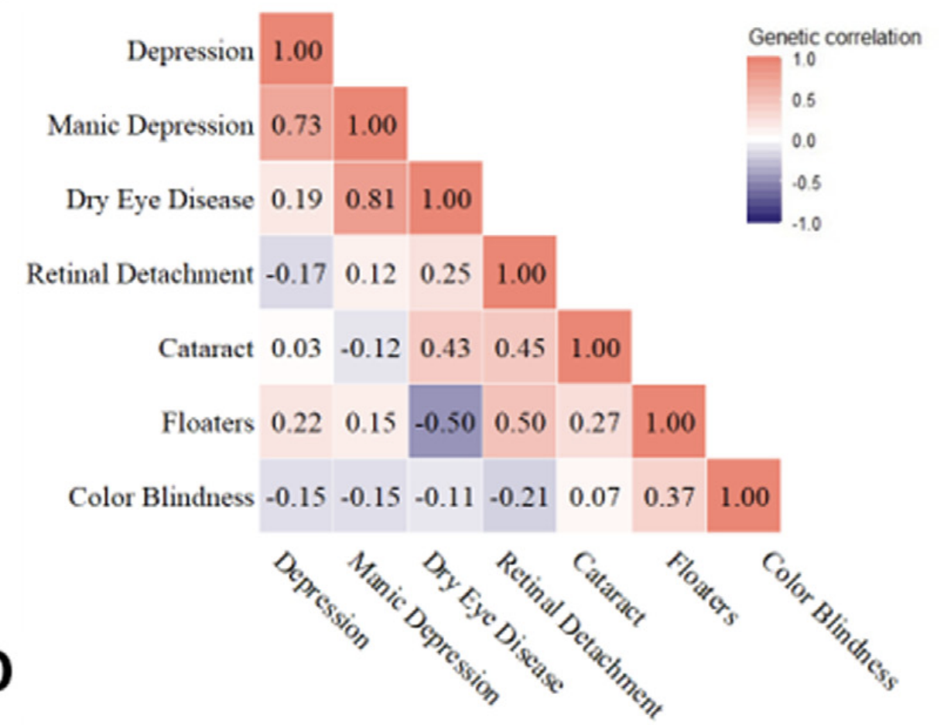
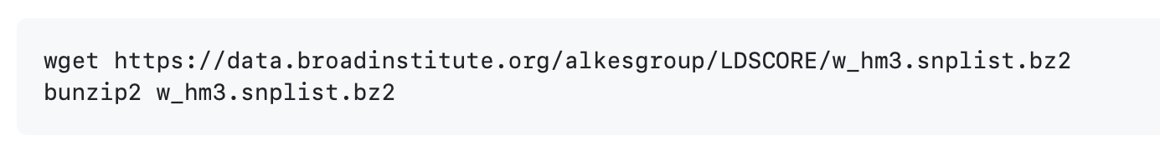
LAVA/LDSC problem
LAVA
most locus dropped due to negative variance estimate
SNPs insignificant
LD structure not matched to reference panel
1000g East Asian (CDX, CHB, CHX, JPT, KHV) N = 629
.bed/.bim/.fam file
–
LDSC
required for LAVA to adjust for population overlap
ldsc require reference panel
Notes:
GO p<0.05 overlap selected manually, gene < 0.01 in A and B, gene < 0.05 in C
String PPI top 100 MAGMA p genes, single node or pair-pair removed

Slide 9
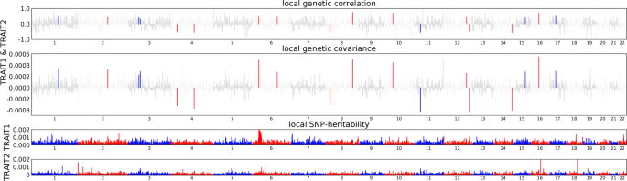
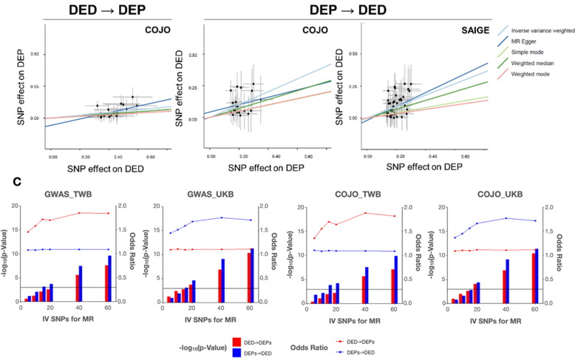
To-do
plot for LAVA
plot for MR

Slide 10
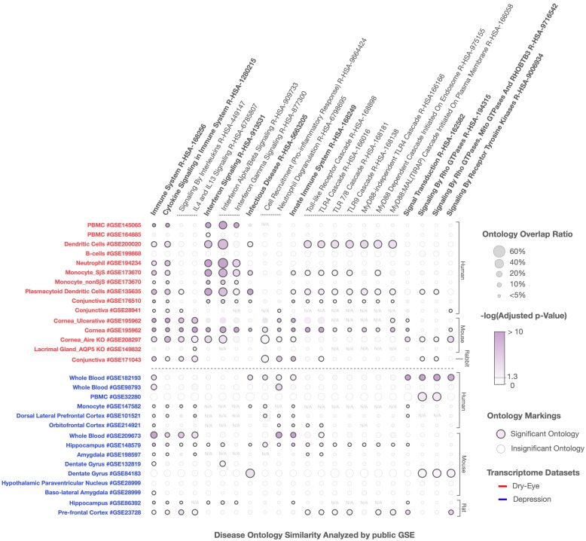
To-do
transcriptomic review
Coloc
–
LDSC
TWB2 bed/bim/fam file?

Slide 11
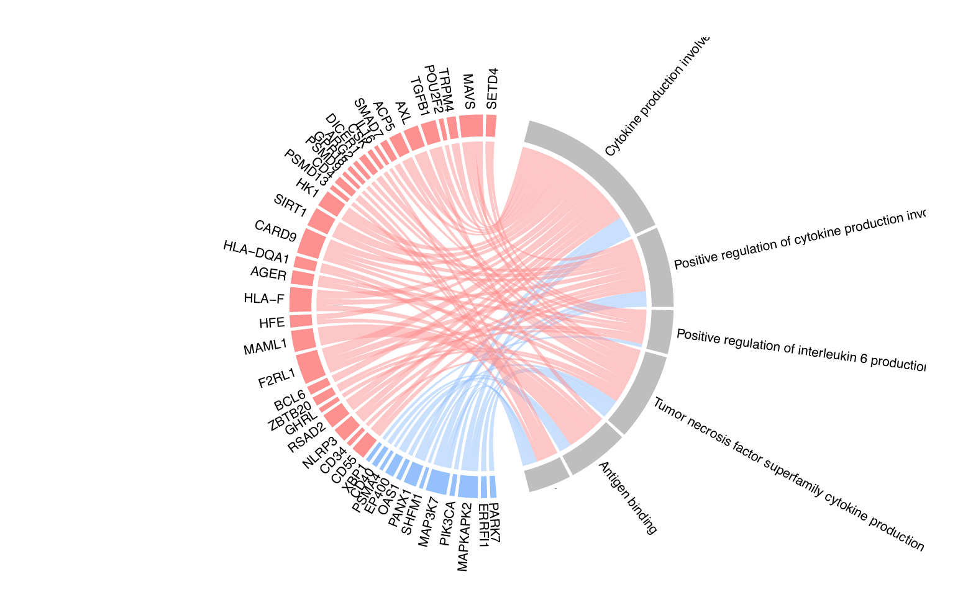
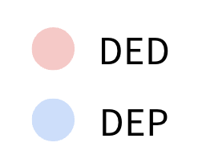
A
Cytokine production involved
in immune response
Positive regulation of cytokine production
involved in immune response
Positive regulation of interleukin 6 production
Tumor necrosis factor superfamily
cytokine production
Antigen binding
T-cell receptor signaling

Slide 12
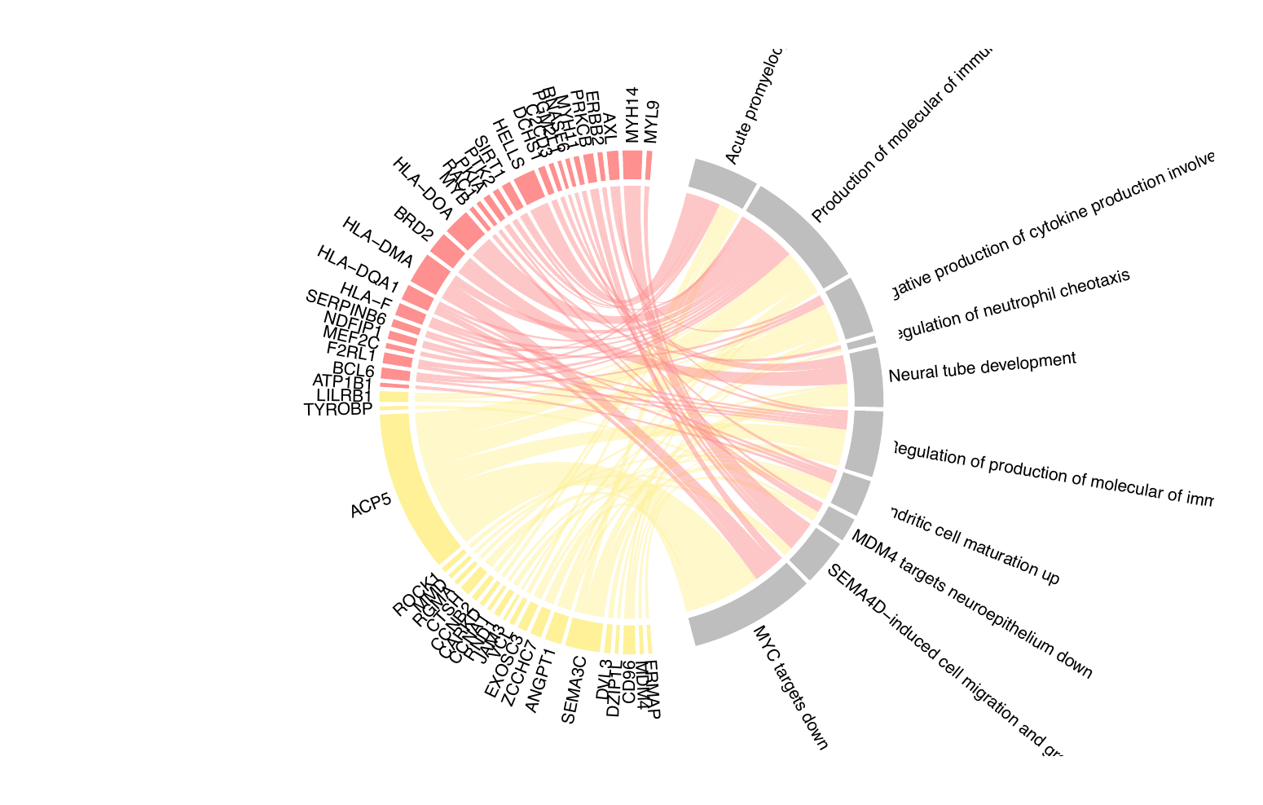
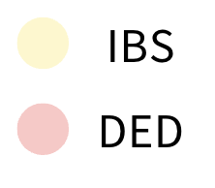
B
Acute promyelocytic leukemia down
Production of molecular of immune response down
Negative production of cytokine production involved in immune response
Regulation of neutrophil cheotaxis
Neural tube development
Regulation of production of molecular of immune response
Dendritic cell maturation up
MDM4 targets neuroepithelium down
SEMA4D-induced cell migration and growth cone collapse
MYC targets down

Slide 13
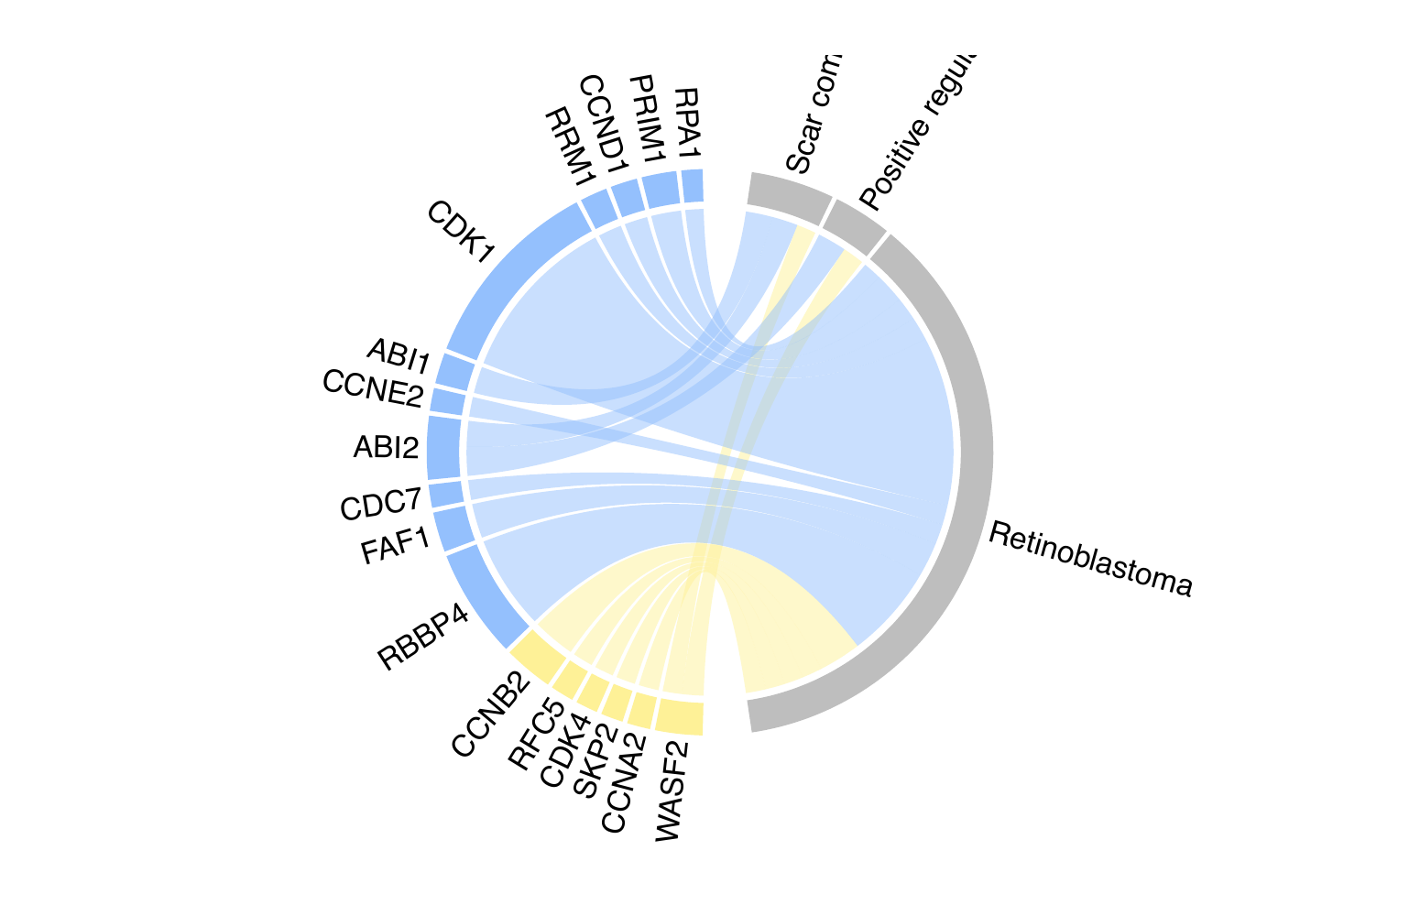
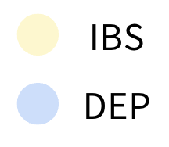
C
Positive regulation of APR2/3 complex mediated actin nucleation
Scar complex
Retinoblastoma

Slide 14
